Slide 1

An Interface To Track Your Ward’s Growth!!

Slide 2
Key Outcomes Of Our Project:
Whatsapp Alert /Notification to the admin who will further provide assistance to the patient.
Increasing the engagement of parents and admins.
User friendly interface with Multilingual Support.
Increasing the database.
Admin can see the statistics based on filter by cities.

Slide 3
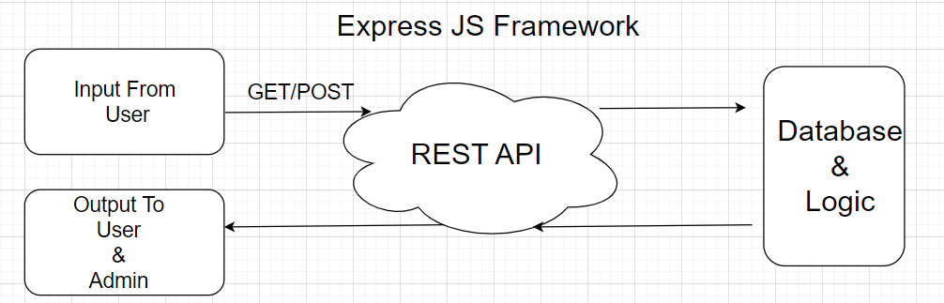
Architecture:

Slide 4
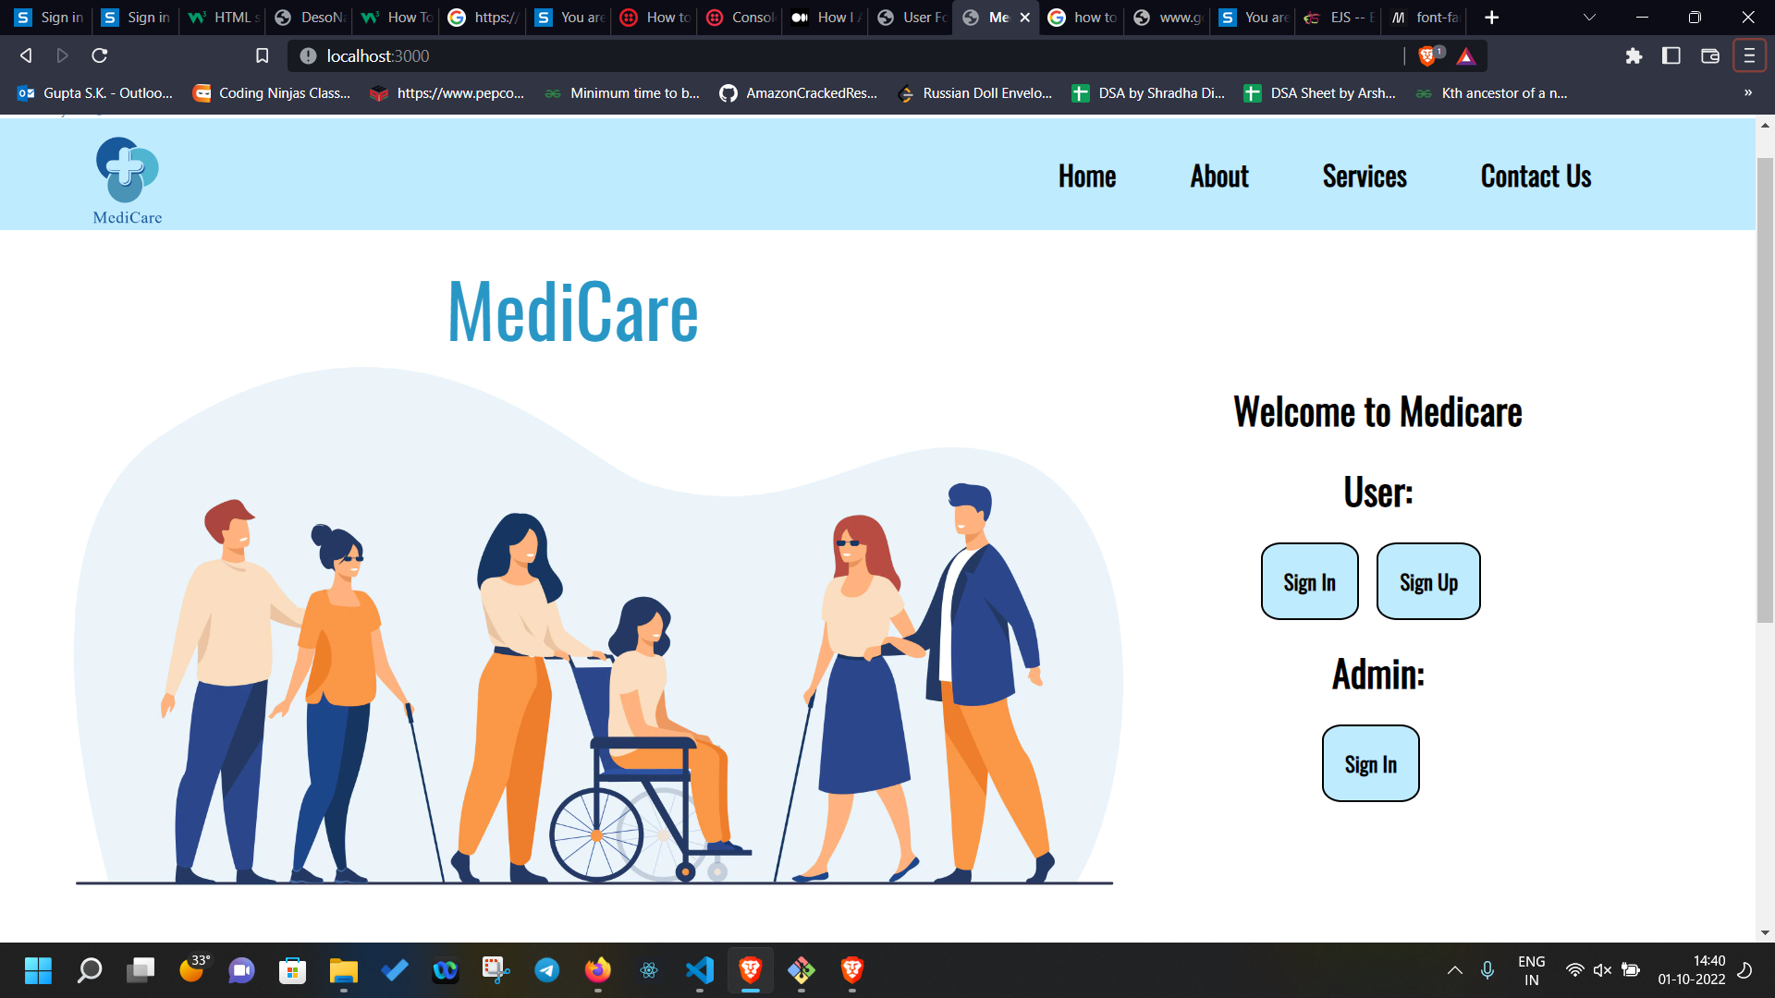

Slide 5
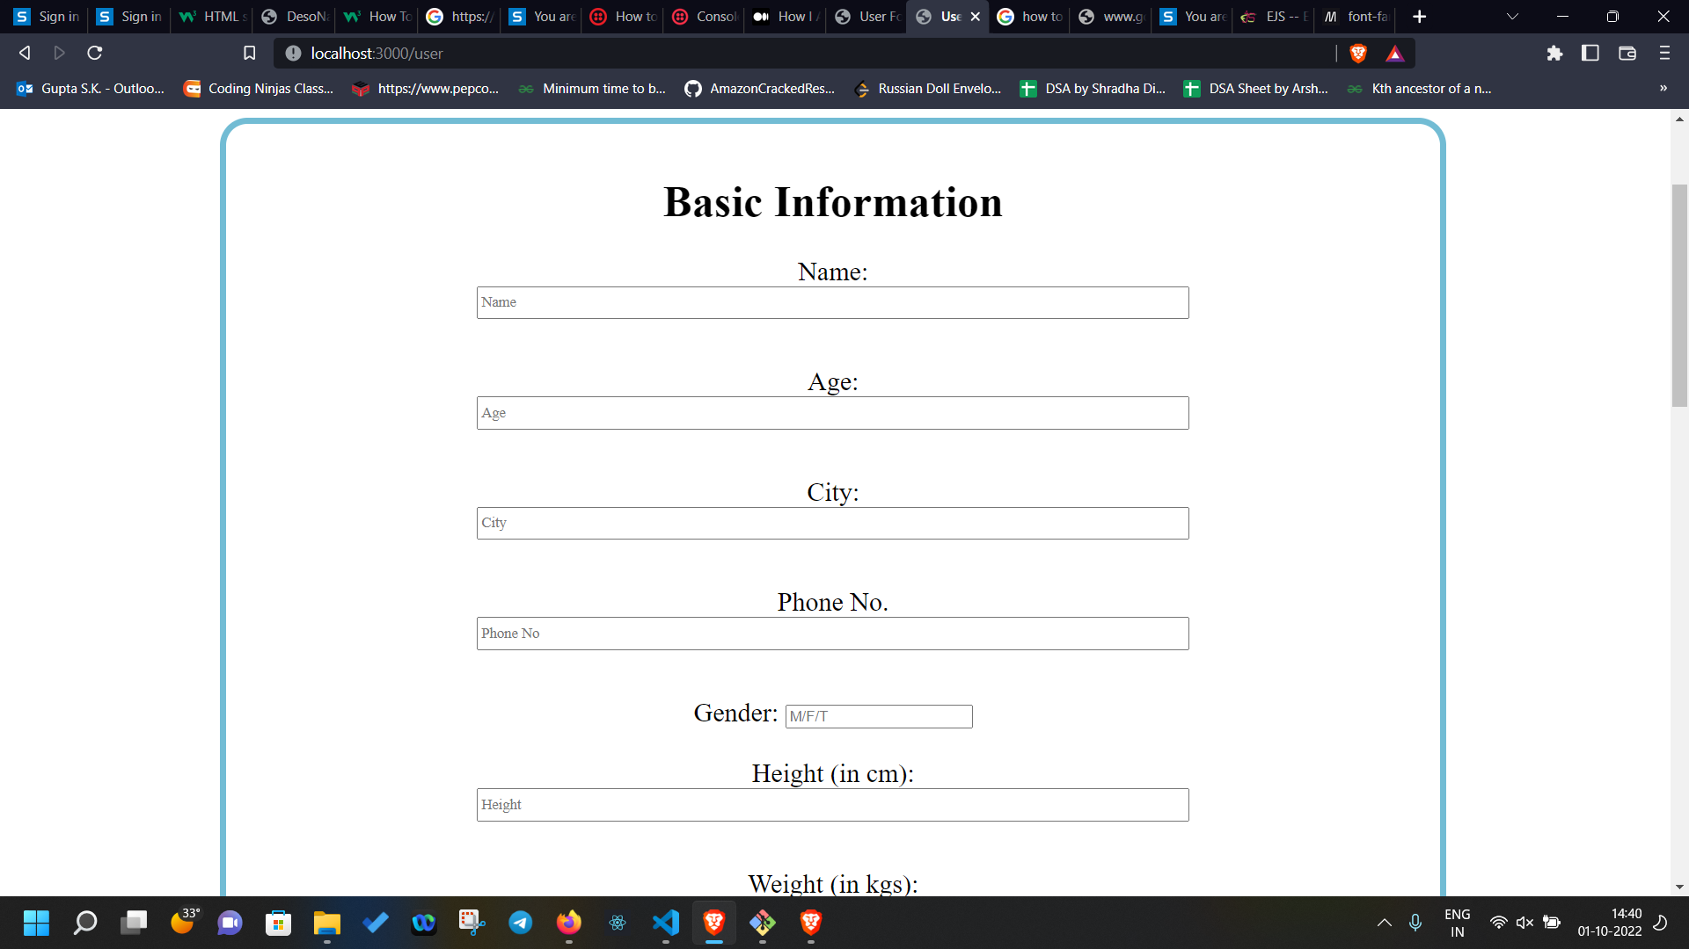
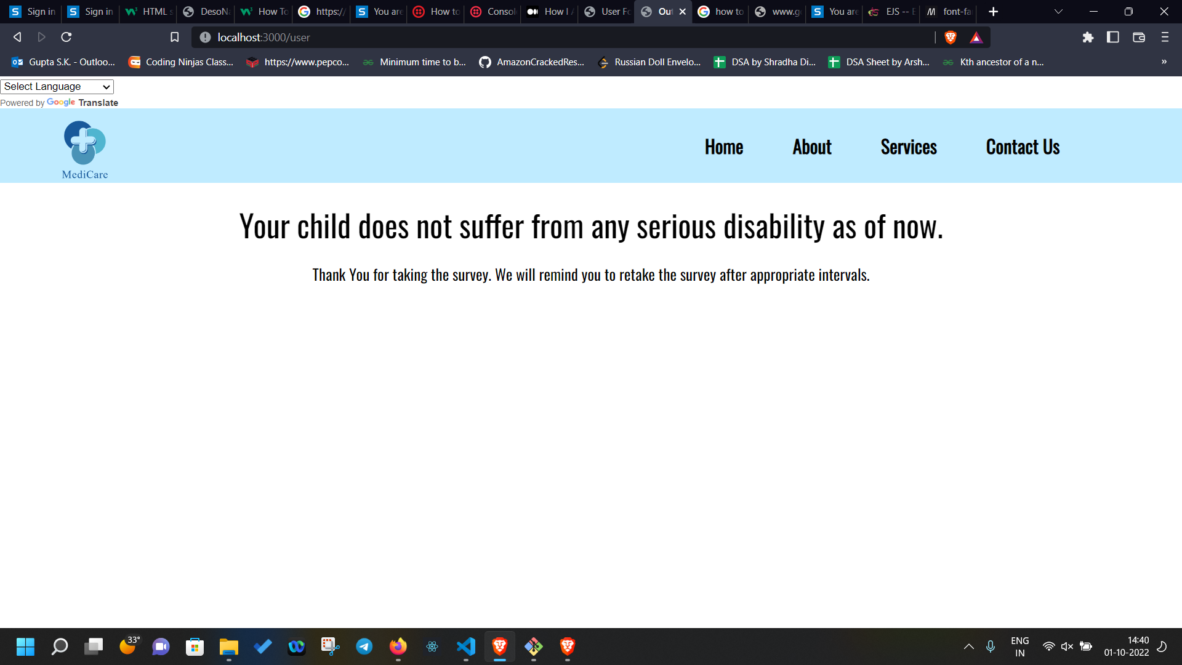

Slide 6
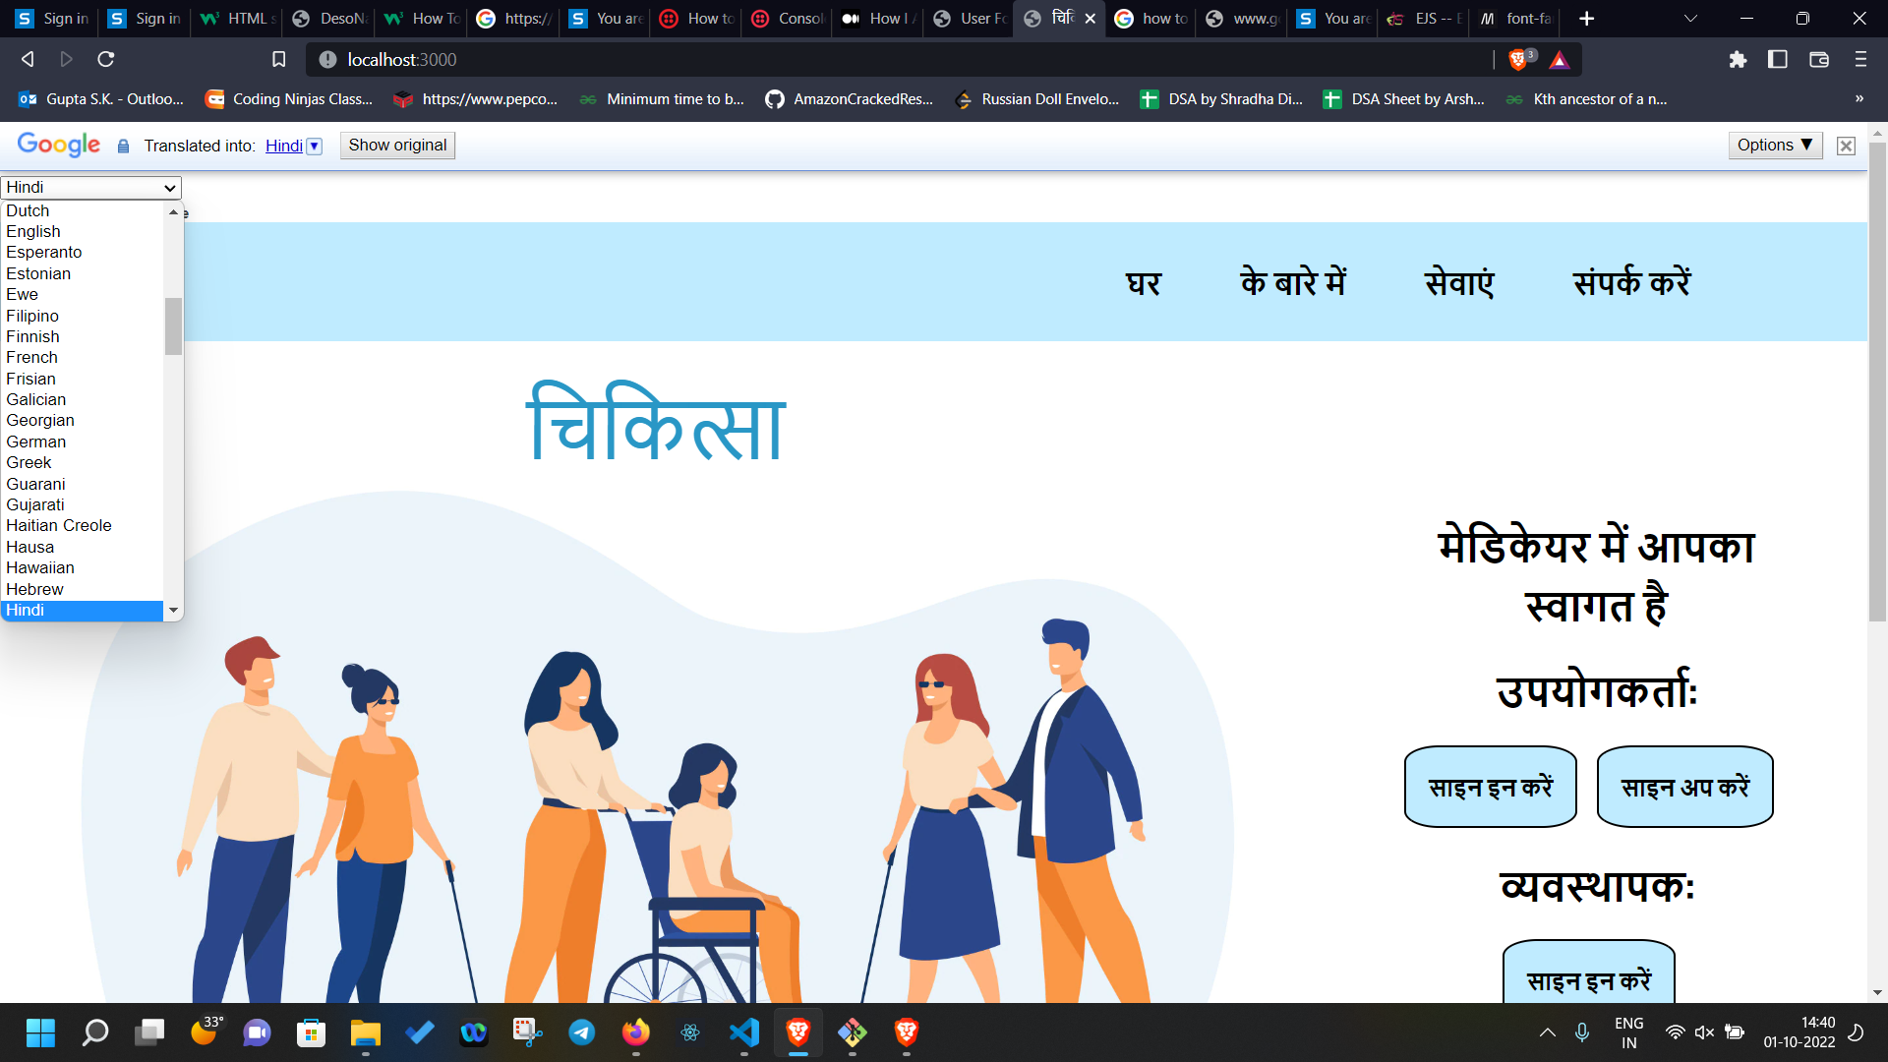

Slide 7
Utilities:
Timely medical assistance
Diagnosis by experts
Location based data collection
Scientifically curated survey

Slide 8
Techstacks Used:
HTML
JavaScript
CSS
EXPRESS JS
NoSQL Database (MongoDB)

Slide 9
Future Integrations:
Alerts and periodic notifications via email as well as through Whatsapp and more interfaces to increase reach to users.
Broadening the questionnaire.
Making a smart recommendation system which can provide basic assistance to users straight away.
Integrating growth charts and plots for improved tracking.

Slide 10
Thank You
Team : TWNN
Members:
Ankur Gupta (21103028)
Akash Rout (21103080)
Sparsh Singh (21103084)
Ujjawal Gupta (21103079)

